Slide 1

A Proposal Defence on Project
“VOTIX”
Presented by:
Aadarsan Dahal
Nimesh Adhikari
Rishav Adhikari
Bal Kumar Shrestha
June 2025

Slide 2

VOTIX
Introduction
Opinion Sharing Website
Focused on sentiment based engagement
Promotes opinion -driven discussions
June 2025

Slide 3
VOTIX
Objectives
To enable structured debates through public participation.
To offer sentiment-based feedback on controversial topics.
To encourage meaningful online discussions over viral content.
June 2025

Slide 4
VOTIX
Features
Sentiment Bar on each post (Shows whether people agree or not ).
Agree/Disagree Voting System.
Channel-based content sorting.
June 2025

Slide 5
VOTIX
Methodology
UI Design with Figma
Frontend using HTML, CSS, JavaScript
Backend using Firestore.
June 2025

Slide 6
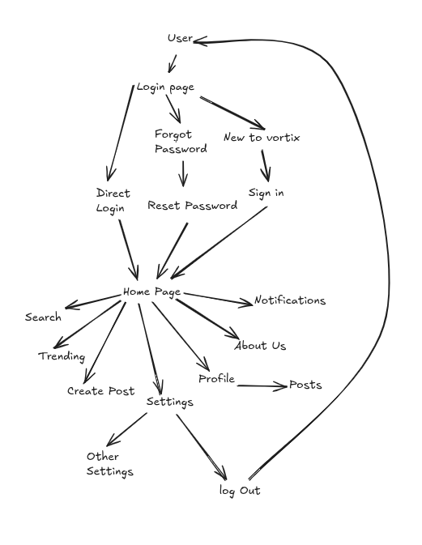
VOTIX
Wireframe
(Navigation)
June 2025

Slide 7
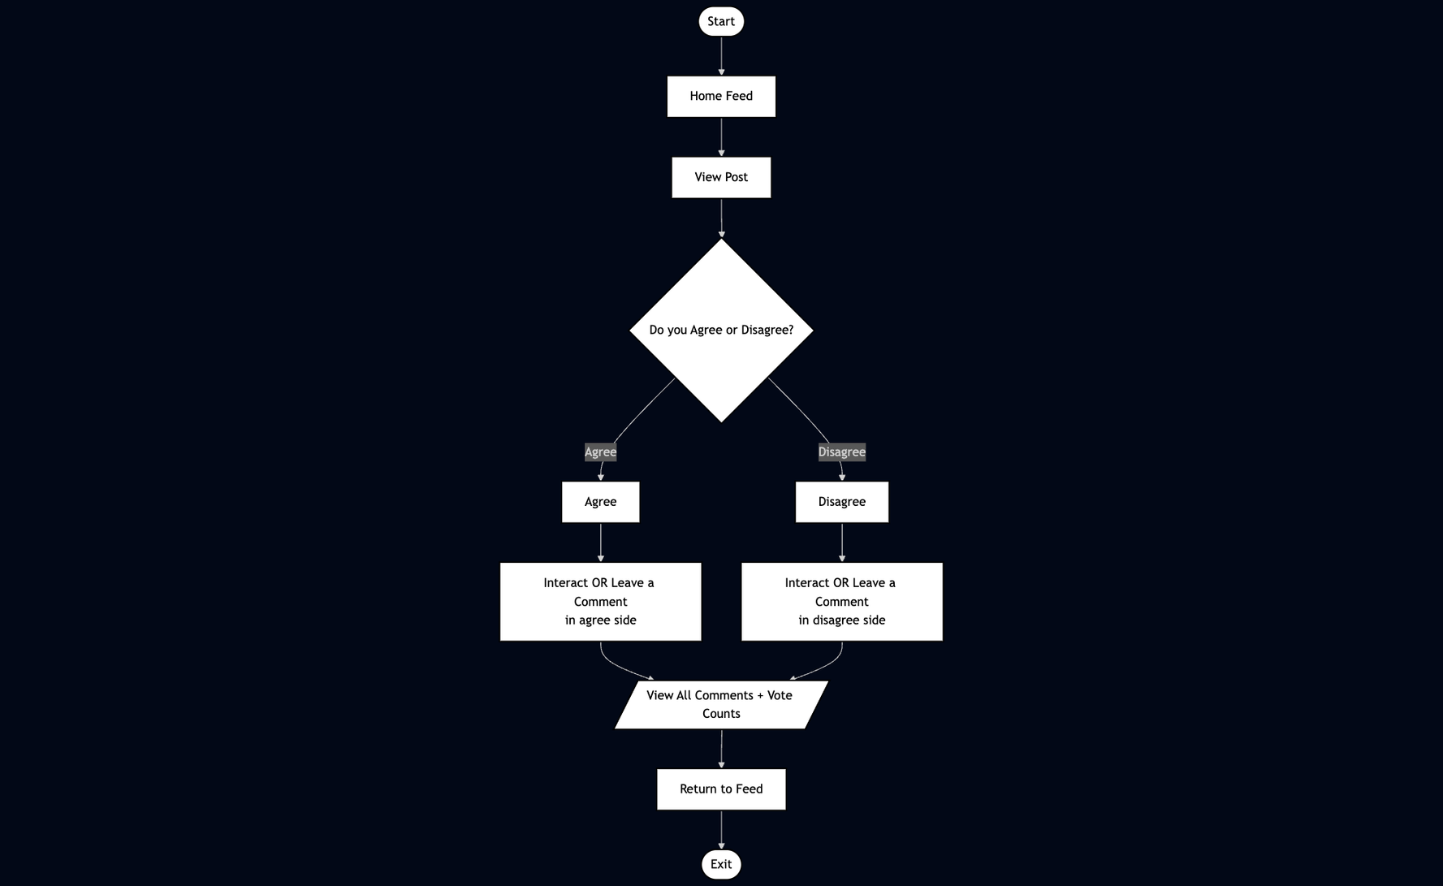
Flow Chart
VOTIX
June 2025

Slide 8
VOTIX
System Requirements
SOFTWARE
HARDWARE
Visual Studio Code
Figma
Firebase Console
GitHub
Desktop/Laptop
Internet access
June 2025

Slide 9
VOTIX
Feasibility Study
Economic:Uses mostly free tools.
Technical : Webstack is beginner-friendly
Operational : interface is intuitive and useable across devices.
June 2025

Slide 10
VOTIX
Budget Analysis
4 Developers
90 Days
Miscellaneous Allowance: Rs. 10,000
Total Cost: Rs. 50,000
June 2025

Slide 11
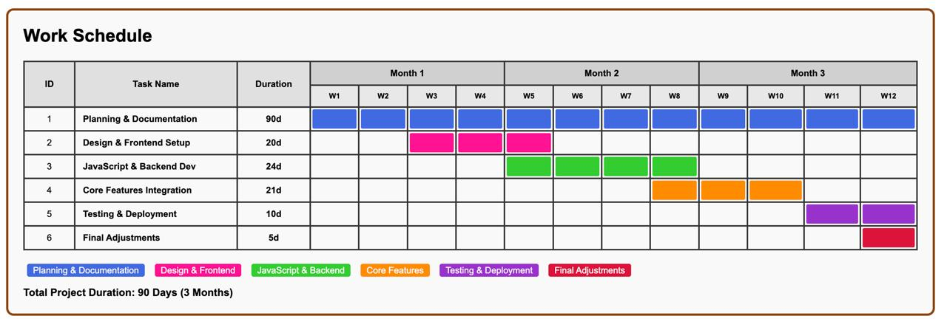
VOTIX
Work Schedule
June 2025

Slide 12
THANKYOU
The votix Crew

